Slide 1

Rookie QB Success Prediction Model
Akil Thomas

Slide 2
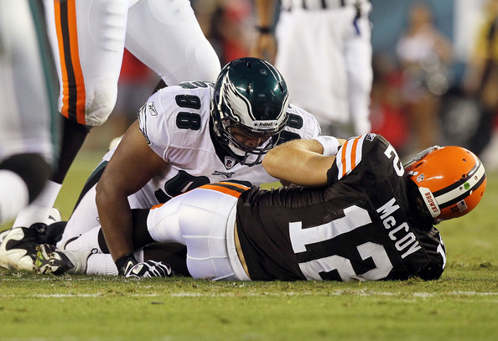
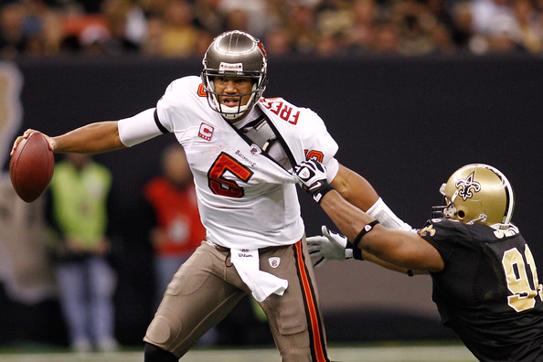
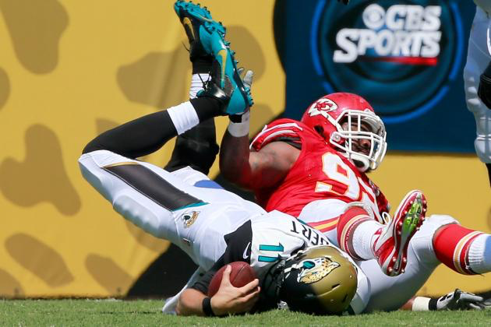
Project Question
Can we predict a Rookie QB starting in the NFL will have a “successful” season (7 wins or more) utilizing College Football statistics (Passer Effeciency Rating, winning percentage, TDs per game, passing yards per game, etc.).
Background
In the past decade there has been a large increase in Rookie QBs starting in Week 1. NFL teams have burned through a large amount of money completely relying on these Rookie QBs to make an immediate impact.
Notable Train Wrecks:
Colt McCoy(5-11), Josh Freeman(3-13), Blain Gabbert(5-11)
Notes:
Recent Rookie Staters: Andrew Luck, RG3, Rusell Wilson

Slide 3
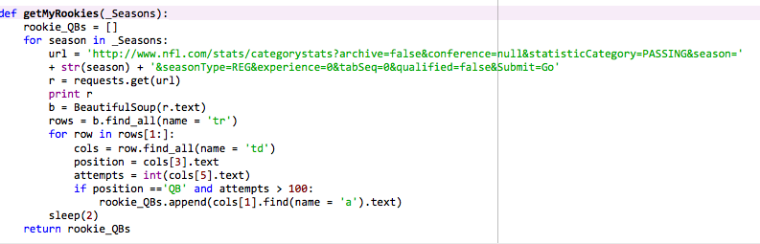
Data Gathering
Web scrapped NFL.com to compile a list of name of QB that started their Rookie Season from 2014- 1980.
Once I got my player names, I webscraped sports-refrence.com to retrieve the CFB stats for each player

Slide 4
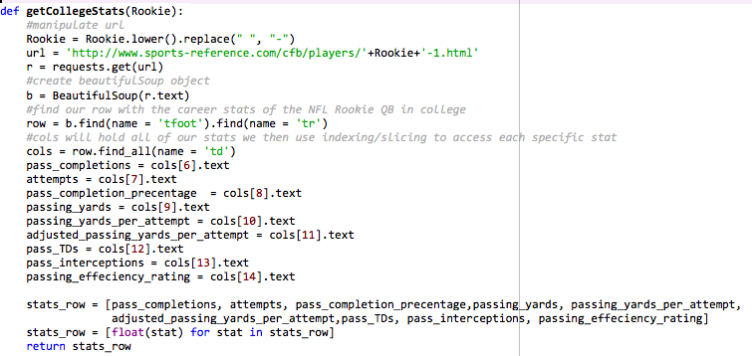
Data Gathering Continued…

Slide 5
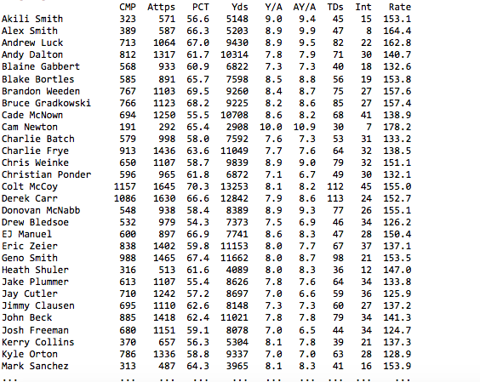
Dataset Completed
Characteristics
67 Datapoints
9 Features
Notes:
pass_completions, attempts, pass_completion_precentage,passing_yards, passing_yards_per_attempt,adjusted_passing_yards_per_attempt,pass_TDs, pass_interceptions, passing_effeciency_rating

Slide 6
Next Steps and Limitations
Limitations
Small sample size
Some rookies in the data haven’t necessarily started week 1. Some started in week 2 or week 3. Which may skew data
Next Steps:
Retrieving the W/L record for their Rookie Season, which will be my repsonse
Feature Engineering
Selecting the right model
Test Model
Notes:
Only have 67 data points

Slide 7
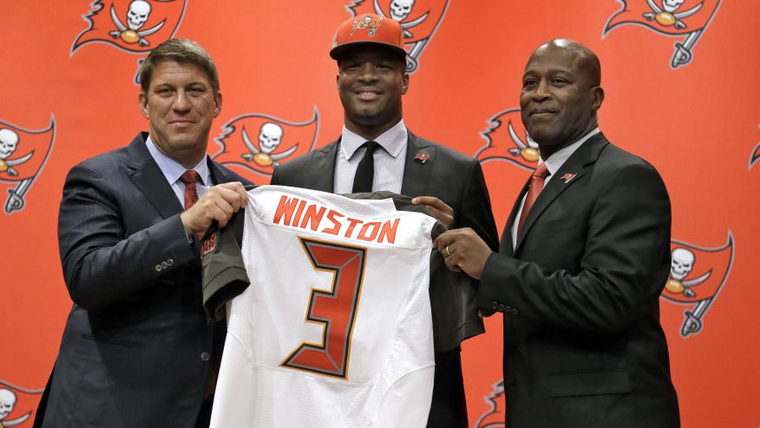
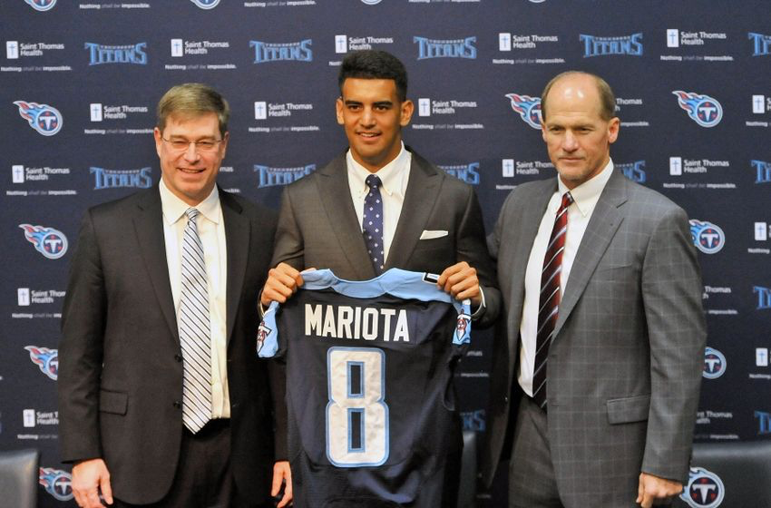
Goals for our model prediction
Our goal is to be able to accurately predict if newly drafted QBs will lead there teams to a “successful” season

Slide 8
Questions

